Slide 1
Harlem Election Rematch
Money And Demographics in the 13th
Haronil Estevez
@he8897
github.com/he334/pygotham2014

Slide 2
Summary
Congressional Electoral Process
History of New York’s 13th Congressional District
Recent Demographic Changes in the 13th
Open Source Government Data
Using Numpy, Pandas, and Matplotlib To Analyze and Visualize Campaign Data

Slide 3
Reapportionment Process
Each State Gets “X” Number Of House Representatives
Number of Reps Based on Population Totals
Last Census Taken 2010
435 Congressional Seats

Slide 4
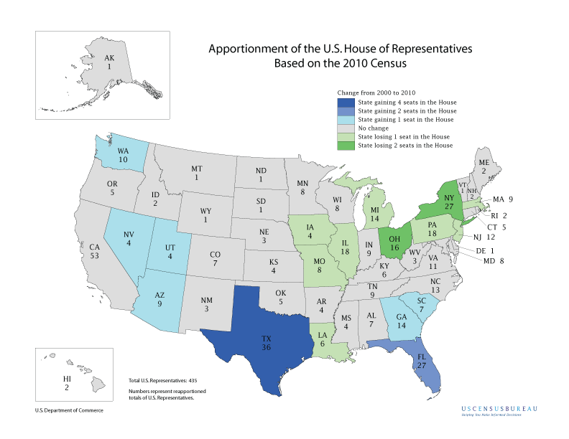

Slide 5
Redistricting
Dividing Geographic Area of State Into Congressional Districts
Not Always Straightforward, Sometimes Imposed By Judges (New York)
Not Without The Risk Of Gerrymandering

Slide 6
Gerrymandering
Using The Power Of Redistricting to ensure that one party, candidate, or ethnic group gets to dominate the politics of a particular district

Slide 7
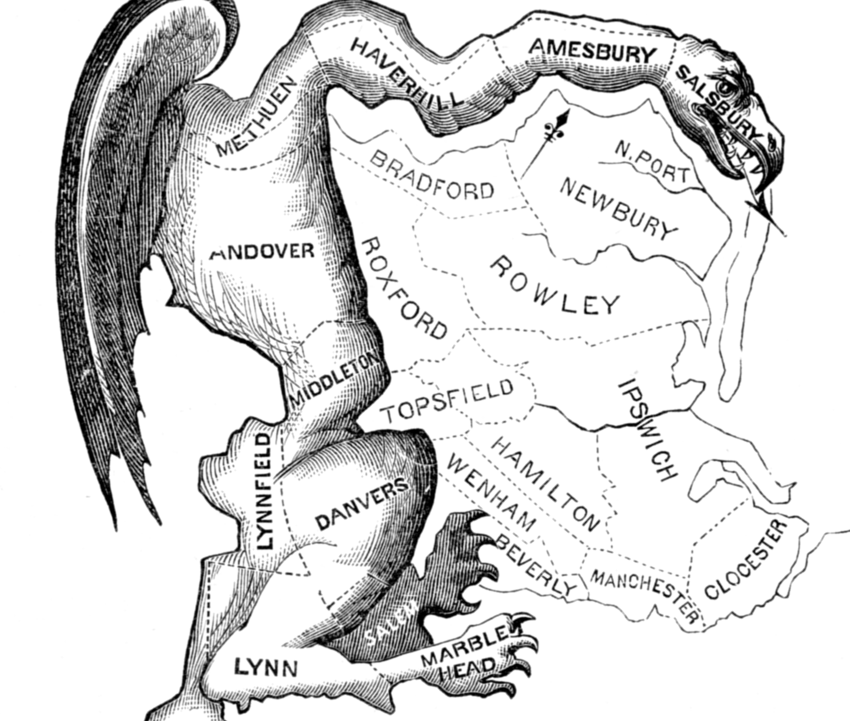
SOURCE: Wikipedia

Slide 8
Prohibitions On Redistricting
The Voting Rights Act of 1965
9 states with a history of racial discrimination need approval from the United States Justice Department before implementing redistricting plans
Shelby County v. Holder - struck down the formula used to determine which states are subject to this prohibition

Slide 9
History of New York’s 13th Congressional District
Majority minority.
Both Manhattan and The Bronx
Italian and Jewish At Beginning Of 20th Century
Adam Clayton Powell Jr. 13th’s first black congressman
Great Migration of African Americans From The South To Northern States
Represented For Decades by Democratic Congressman Charles Rangel

Slide 10
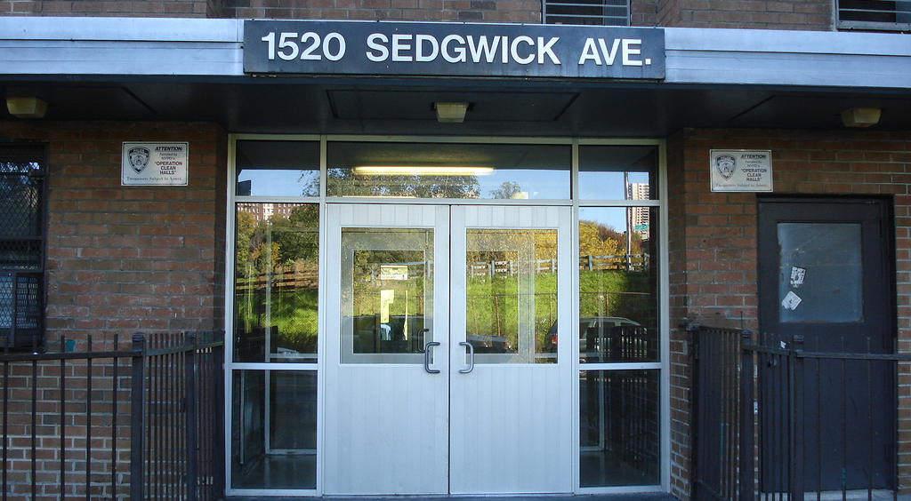
‪Birthplace of Hip-Hop
SOURCE: Wikipedia

Slide 11
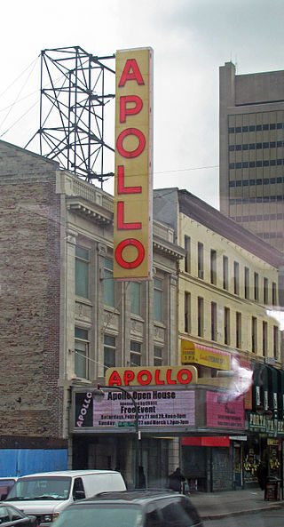
Apollo Theatre in Harlem
SOURCE: Wikipedia

Slide 12
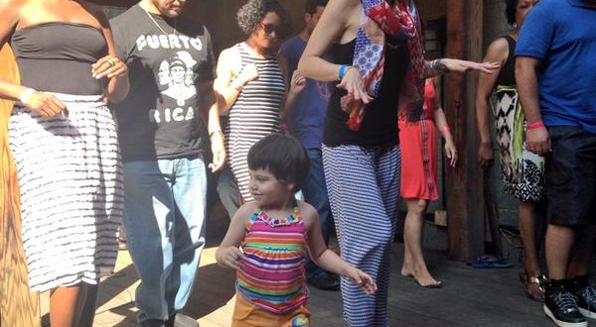
Plena y Bomba At La Caza Azul
SOURCE: pic.twitter.com/0dw3TtbiCO

Slide 13
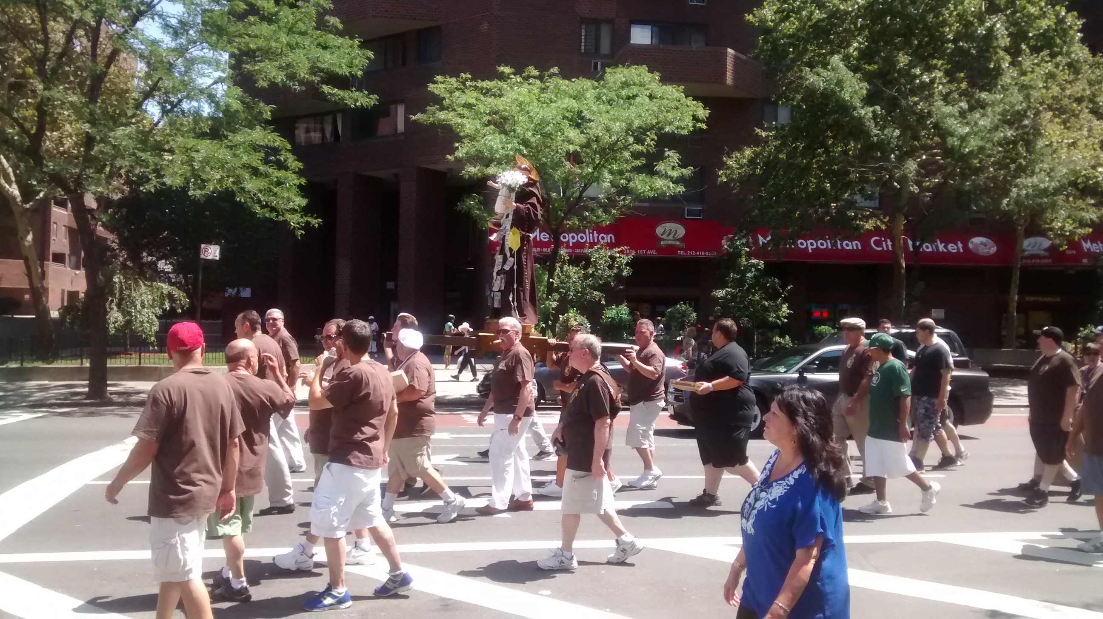
Dancing of The Giglio

Slide 14
Harlem After Second World War
Adam Clayton Powell Jr.
The Second Great Migration
Economic Troubles Of 70’s and 80’s
Revitalization

Slide 15
Recent Demographic Shifts in the 13th
Increase in number of Latinos And Asians Living In The 13th
15th congressional district was replaced with the 13th as part of the decennial redistricting
New district includes parts of South Bronx and has a larger Latino population
Senator Espaillat ran against Rangel in 2012 hoping to take advantage of these demographic shifts
Espaillat lost by less than 1,100 votes and ran again in 2014

Slide 16
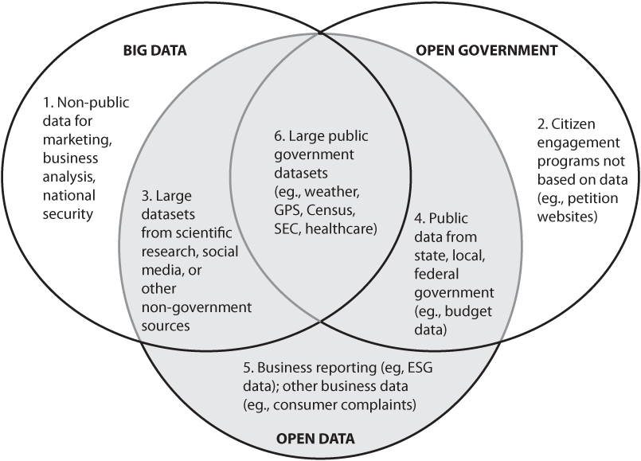
Open Data
SOURCE: Open Data Now by Joel Gurin

Slide 17
Open Source Government Data
May 2013 – Obama announces Open Data Policy
More machine-readable government data

Slide 18
Open Data 7 Key Criteria
Public
Accessible
Well Described
Reusable
Complete
Timely
Managed postrelease

Slide 19
Interested in 4 Types Of Data
Census Burea Demographics Data
Geographic Boundaries Data For Assembly and Congressional Districts
Campaign Contribution Data
Voting Results Data by Congressional and Assembly District

Slide 20
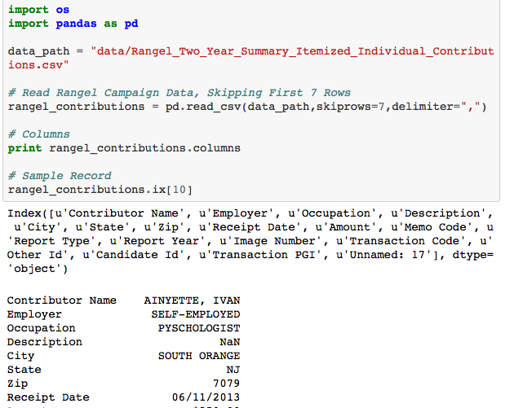

Slide 21
Census Data
American FactFinder website lets you search based on:
Topics (age, income, year)
Geographies (state, counties, places)
Race and Ethnic Groups
"QT-P03" census table for both the 111th and 113th New York Congress
State Assembly and Congressional District Geographic Shape Files from New York State's Department of City Planning

Slide 22
Shape Files
Interested in .shp and .dbf files
.shp file contains the geometry, like points, lines, and polygons
.dbf file contains attributes of the corresponding geometry

Slide 23
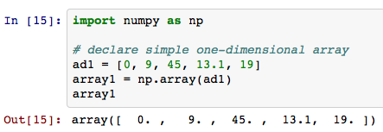
Simple Numpy Examples

Slide 24
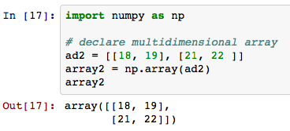
Simple Numpy Examples

Slide 25
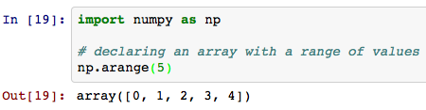
Simple Numpy Examples

Slide 26
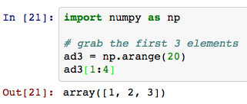
Simple Numpy Examples

Slide 27
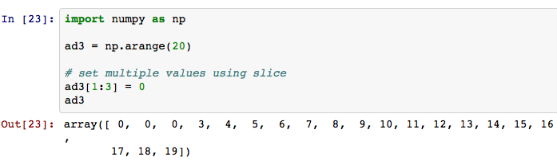
Simple Numpy Examples

Slide 28
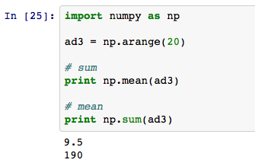
Simple Numpy Examples

Slide 29
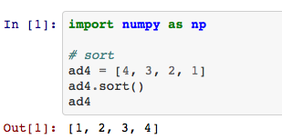
Simple Numpy Examples

Slide 30
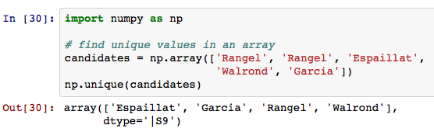
Simple Numpy Examples

Slide 31
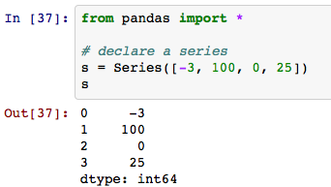
Simple Pandas Examples

Slide 32
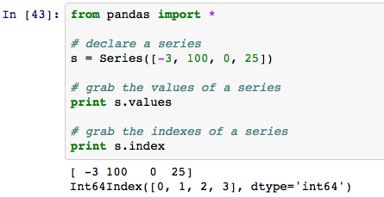
Simple Pandas Examples

Slide 33
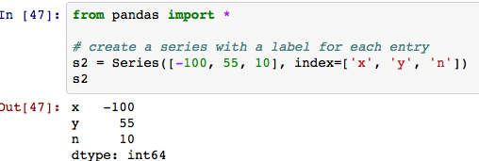
Simple Pandas Examples

Slide 34
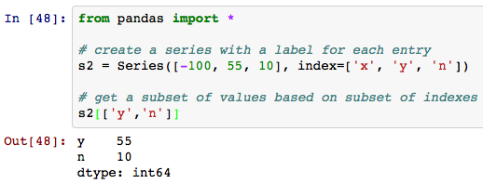
Simple Pandas Examples

Slide 35
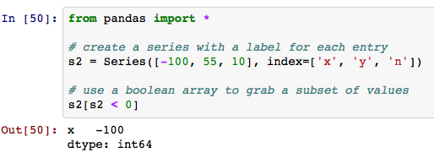
Simple Pandas Examples

Slide 36
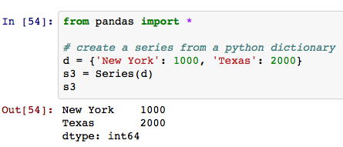
Simple Pandas Examples

Slide 37
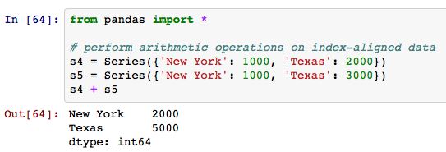
Simple Pandas Examples

Slide 38
If grouped by Occupation, which group donated the most to the winning candidate?

Slide 39
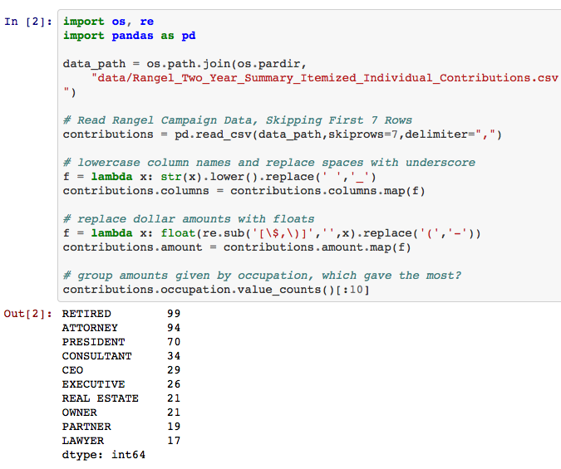

Slide 40
CALCULATING ASSEMBLY DISTRICT DEMOGRAPHICS BASED ON CENSUS DATA

Slide 41
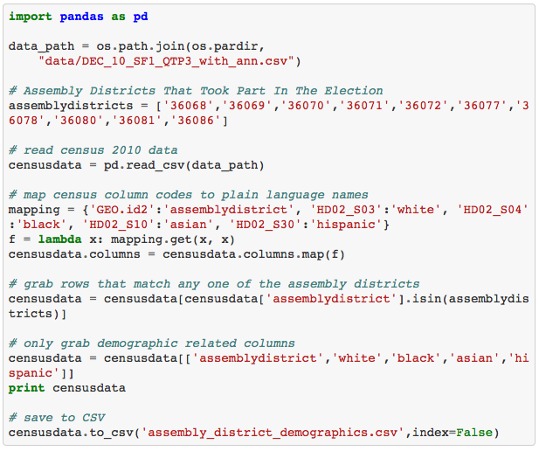

Slide 42
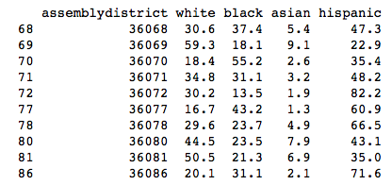
Assembly District Demographics

Slide 43
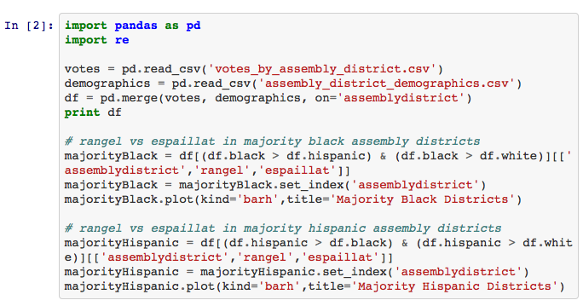
Majority Black or Hispanic Districts

Slide 44
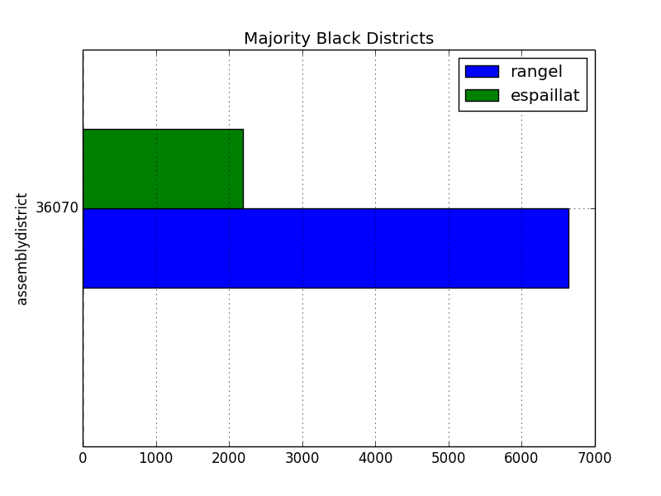

Slide 45
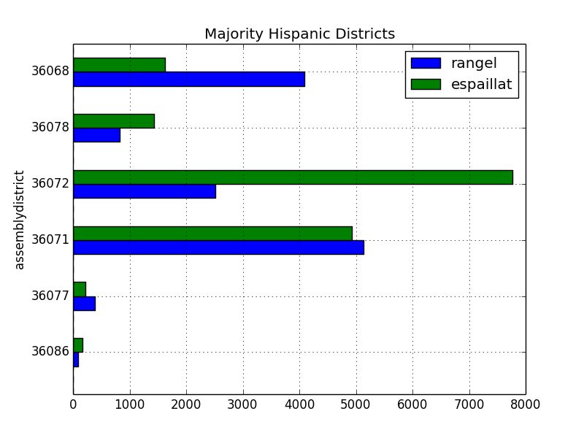

Slide 46
Compare Old 15th Congressional District Map To New 13th

Slide 47
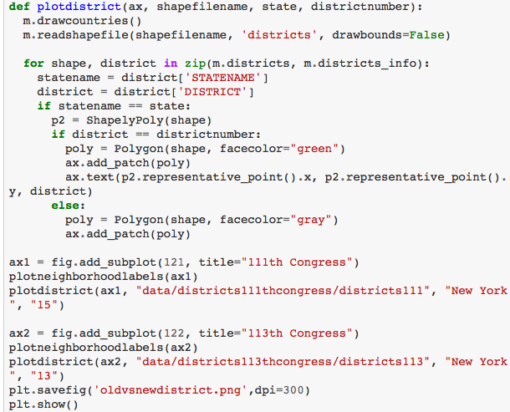

Slide 48
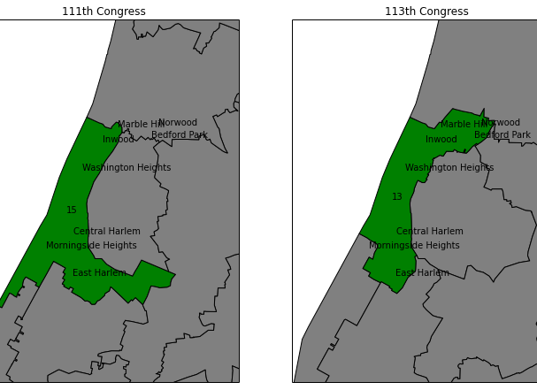

Slide 49
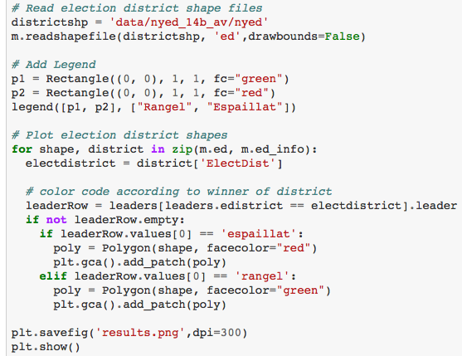

Slide 50
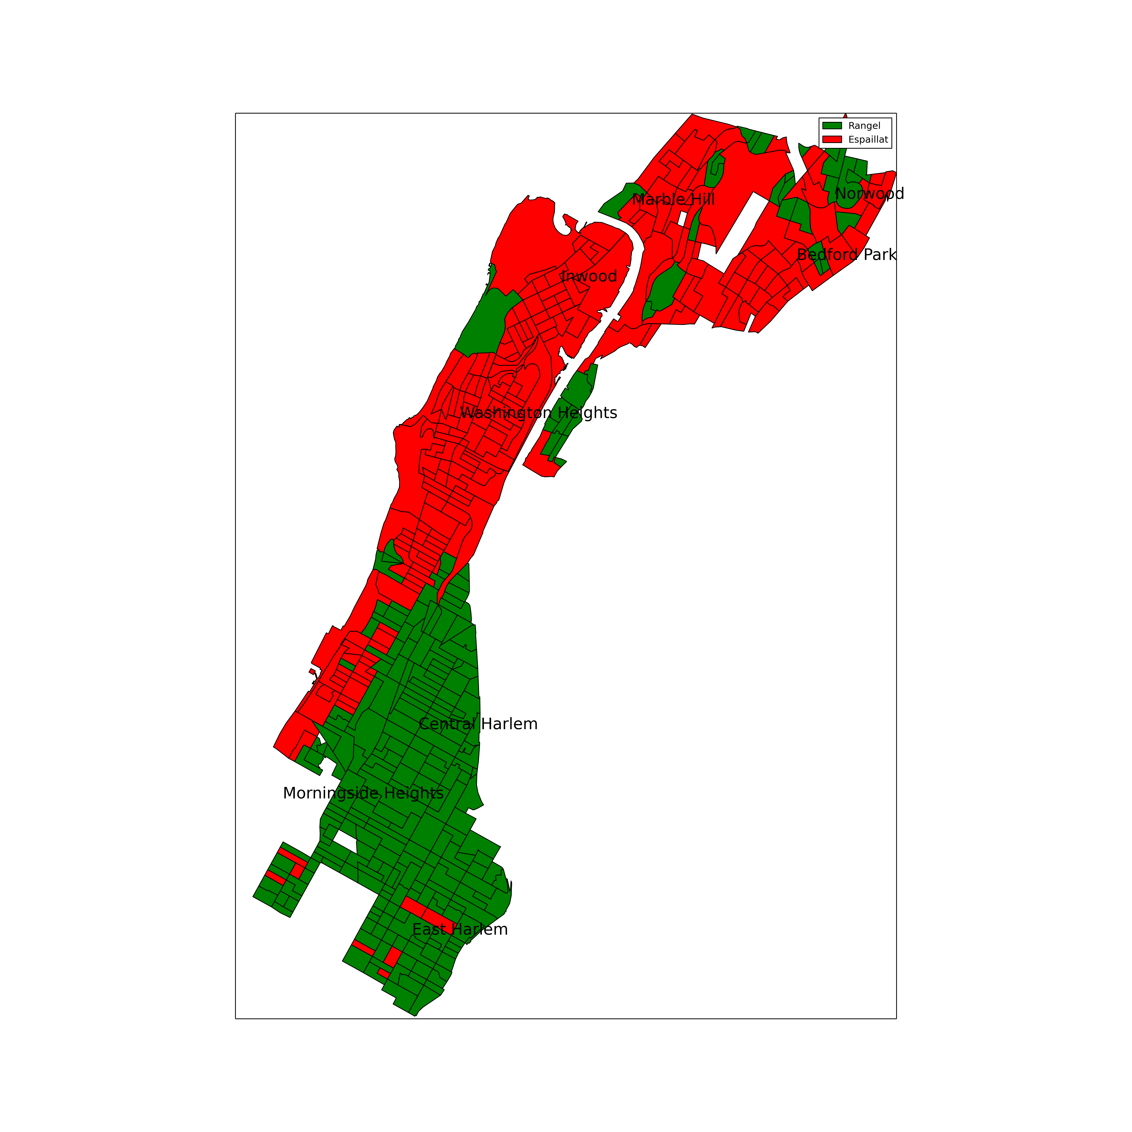

Slide 51
Thanks!
Thanks PyGotham organizers.
Q & A
Slides and IPython notebooks: github.com/he334/pygotham2014
@he8897

